Slide 1
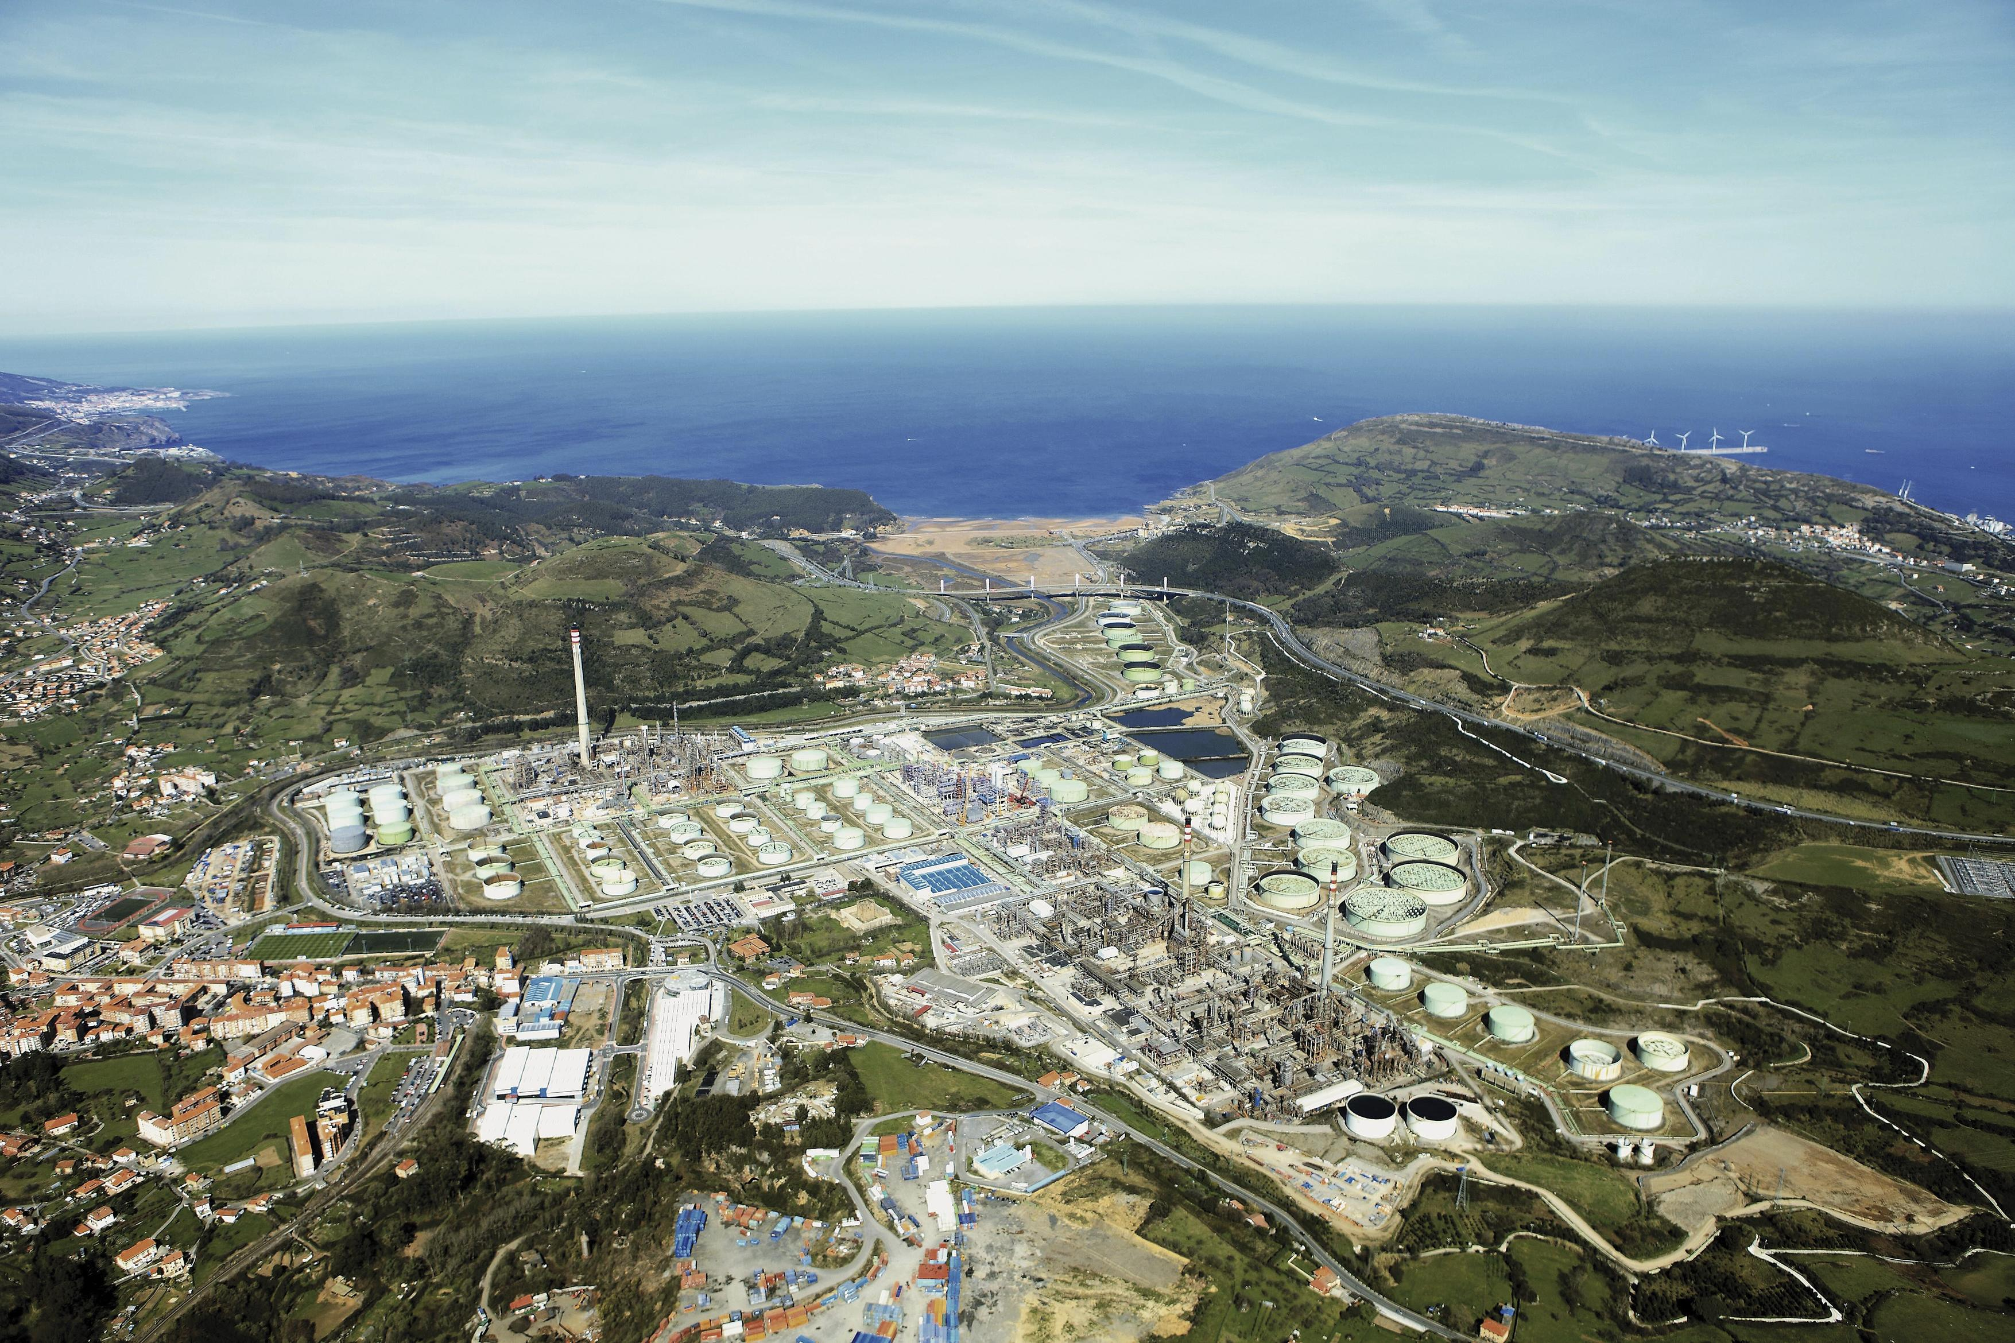



Working together to achieve net-zero
Basque Net-Zero Industrial SuperCluster
Basque Hydrogen Corridor BH2C

Slide 2







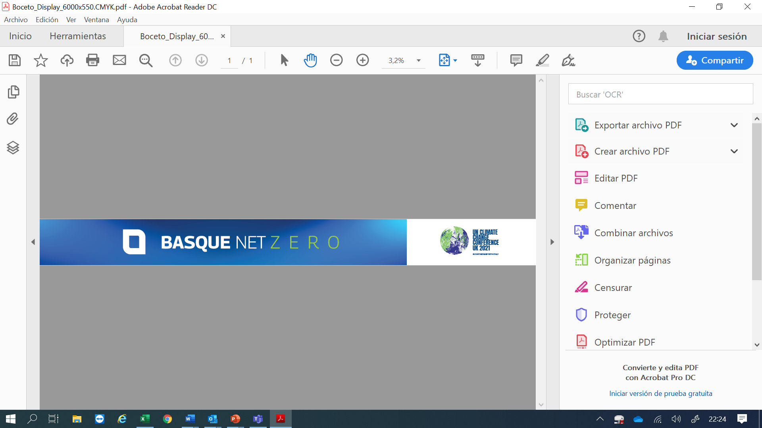
CO²
7,2
204.000
2,2M
MT CO2 per year
Emissions caused by Industry
Population
And 302 Habitants per Km2
Jobs in industry in the Basque region
Industries addressed 1st phase
CO²
BASQUE
CLUSTERS
Basque
Industry
Oil Refining
23,9 %
46,15%
Cement
Industry Contribution to GVA in 2019
Of GHG Emissions are emitted by Industries
Steel
Foundry
Pulp & Paper

Slide 3












BASQUE HYDROGEN CORRIDOR: Initiatives, Structure and Numbers
Driver Projects
Cross-Cutting
Action groups
Renewable Hydrogen Production
and
Synthetic Fuels
Mobility and Logistics
End-users decarbonisation:
Industrial sectors, services and residential
Infrastructure
Industrial
Technology Development
Enabling Projects
1
2
3
4
5
6
No. of projects
4
7
1
3
15
3
Investment
EUR 826.8 M
EUR 78.7 M
EUR 139.5 M
EUR 42.2 M
EUR 294.8 M
EUR 78.7 M
Action group leader

Slide 4






















The BH₂C spans 33 projects distributed all along the hydrogen value-chain.
PRODUCTION
STORAGE/ TRANSPORTATION
END USES
H₂O
RENEWABLE ELECTRICITY
H₂
Ammonia and H₂-bearing organic liquids
STORAGE
INDUSTRY
3 Technological Projects
1 Application Project
2 Application Projects
1 Technological Project
H₂ and liquefied H₂
4 Technological Projects
SECTOR INTEGRATION
CIRCULAR ECONOMY
MOBILITY
Synthetic natural gas (Power-to-gas)
TRANSPORTATION
4 Technological Projects
4 Application Projects
2 Application Projects
2 Technological Projects
Synthetic liquid fuels
(Power-to-liquid)
5 Application Projects
1Application Project
OTHERS – RESIDENTIAL
CO₂
1 Technological Project
CROSS-CUTTING PROJECTS
3 Application Projects

Slide 5
















































Slide 6

cristina@spri.eus
arturo.fernandez@repsol.com
aisasa@basquetrade.eus

